Slide 1
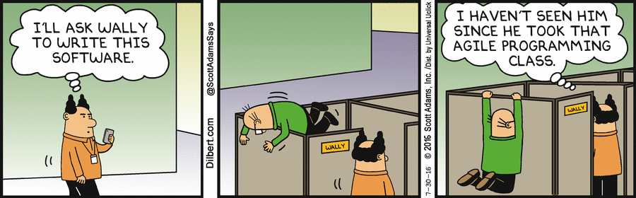
Notes:
Speaker: David

Slide 2
μProject - Iteration 3
By OneTeam:
David Blair
Christian Carducci
Juan Landaverde
Sang-Joon Lee
Jacqueline Pham
Srivathsa Rajagopal
Notes:
Speaker: David

Slide 3
Goals
Purpose of Application:
To provide capabilities to support a software project using Agile methodology through a basic project management tool package.
Major Functionalities:
Management Component - Planning and Tracking Requirements; macro level
Communication Component - Group and Private channels
Issue Management Component - Planning and Tracking progress; micro level
General Idea
Clean UI Usability [Must haves, Wants, Nice to do]
Notes:
Speaker: Srivathsa
Content: Srivathsa
Question to Answer:
- What were the original goals of the project?

Slide 4

Team, Organization, Skills
Juan Landaverde
Project Management Lead
Chris Carducci
PM Iteration 1
Chat Room Lead
David Blair
PM Iteration 2
Issue Management Lead
Srivathsa Rajagopal
Project Management Dev
QA Analyst
Jackie Pham
Issue Management Dev
UX Analyst
Sang-Joon Lee
PM Iteration 3
Project Management Dev
Notes:
Speaker: David
Content: David
Question to Answer:
- Describe the team, organization, and skills

Slide 5
Work Plan
WORK PLAN/PERSON LOADING | DB | CC | JL | SL | JP | SR
Activity Responsibilities:
Queued: Project Management Tool |  |  | XX
Objective 1. Develop foundation of the Project Management Tool (Iteration 1) |  |  | X | * |  | *
Objective 2. Implement primary and secondary functionality (Iteration 2) |  | * | * | X | * | *
Objective 3. Pilot Project Management Tool for quality and finalize documentation (Iteration 3) |  |  | * | * | * | X
ChatNow: Chat System |  | XX
Objective 1. Develop foundation of the Chat System (Iteration 1) |  | X | *
Objective 2. Implement primary and secondary functionality (Iteration 2) | * | X
Objective 3. Pilot Chat System for quality and finalize documentation (Iteration 3) |  | * |  |  |  | X
Bugs: Issue Tracker | XX
Objective 1. Develop foundation of the Issue Tracking System (Iteration 1) | X |  |  | * | *
Objective 2. Implement primary and secondary functionality (Iteration 2) | * | * |  |  | X
Objective 3. Pilot Issue Tracking System for quality and finalize documentation (Iteration 3) | * |  |  |  | X
Notes:
Speaker: David
Content: David
Question to Answer:
- Describe the team, organization, and skills

Slide 6
Software Engineering Process
Agile Methodology: Agile is nothing more than a set of values and principles
Twice a week “stand-up” meetings:
What have you been working on?
Any issues?
What will you work on for the rest of the week?
Iteration project manager acting as Scrum master
3 Iterations
Planning, development, testing, repeat until features are production ready
Work divided in 3 components
Members added to each component
Notes:
Speaker: Juan
Content: Juan
Question to Answer:
- Describe the development and software engineering process
- What attributes from other processes (Bohm, Waterfall) did you use?

Slide 7
Software Patterns
Model View Controller
Model
MySql DB
View - templates
HandlebarsJS
Bootstrap
jQuery, Various small libraries
Controller
NodeJS, ExpressJS, SocketIO
Notes:
Speaker: Juan
Content: -completed
Question to Answer:
- What patterns were used in the development?

Slide 8
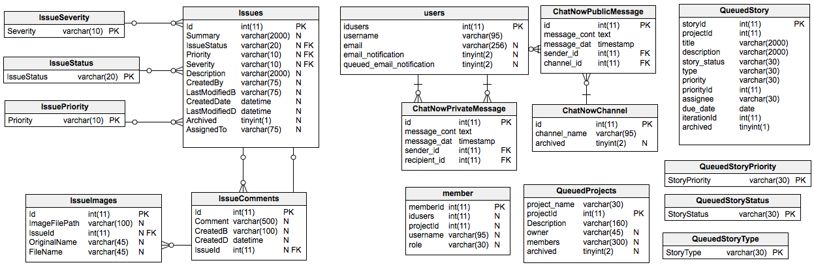
Data Model
Notes:
Speaker: SangJoon
Content: SangJoon/David
Question to Answer:
What is your data model?

Slide 9
Queued: Project Management Tool
Team | Landaverde, Lee, Rajagopal, Carducci, Pham
Features
Must haves
Create and manage users, projects, and stories
Manage story list (backlog, current, done, release)
Wants
Manage iterations
Assign story type
Nice to haves
Multiple projects
Search
View progress, history, and stories by individual
Prioritization via drag-and-drop
View of user owned stories
Email notification on due date
Archive projects, stories
Scroll bar for lists
Notes:
Speaker: SangJoon
Content: SangJoon
Question to Answer:
What was achieved? What was the delta? Why?

Slide 10
Bugs: Issue Tracker
Team | Blair, Pham, Lee, Carducci
Features
Must haves
Create issues
Set priority, severity, and status of issue
Identify who reported issue
Wants
Comment on issue
Assign issue responsibility
Attach screenshots to issue
Nice to haves
Tag and favorite issues
Link issue to Queued story
Maintain history
Custom fields
Filtering of issue list
Notes:
Speaker + Content: Jackie
Question to Answer:
What was achieved? What was the delta? Why?

Slide 11
ChatNow: Chat system
Team | Carducci, Blair, Landaverde, Rajagopal
Features
Must haves
Create a channel
Retain chat history
Wants
Send private messages
Search
Nice to haves
Share files
Audio/Video chat
Email Notifications
Archive/unarchive a channel
Online status of other users
New private message notification
Infinite scrolling
Notes:
Speaker + Content: Chris
Question to Answer:
What was achieved? What was the delta? Why?

Slide 12
Software Pilot
How did using the program “uProject” affect the project?
More functionality
More testing
Notes:
Speaker + Content: Chris
ChatNow notifications
Good level of testing
Focused on more essential features
Question to Answer:
How did you using the program you created affect your project?

Slide 13
Retrospective
Did the process change during the semester? How? When? Why
Iteration 2
Each meeting spoke about what we did in the past week, what we are working on next week, and if anything is holding us up.
For a software engineering perspective, what went well? What could have gone better? What improved over the semester? Why?
Planning lead to a consistent flow of work.
Over the semester, team discussed better and played to individual strengths.
Last minute changes can make you sink or swim.
Agile worked well for our team: Extreme Programming
Communication, Simplicity, Feedback (Short Loops), Courage, Respect,
Deliver working software frequently, self-organizing team, Continuous Integration, Incremental Design
Improvement - Test First Programming (Lack of)
Notes:
Speaker: David Or SJ
Content:
Question 1:David
Did the process change during the semester? How? When? Why
Question 2: Sang Joon
For a software engineering perspective, what went well? What could have gone better? What improved over the semester? Why?
The methodology is based upon five underlying values: communication, simplicity, feedback, courage, and respect.
o Communication. XP has a culture of oral communication and its practices are designed to encourage interaction. The communication value is based on the observation that most project difficulties occur because someone should have spoken with someone else to clarify a question, collaborate, or obtain help. “Problems with projects can invariably be traced back to somebody not talking to somebody else about something important.” [6]
o Simplicity.
Design the simplest product that meets the customer’s needs. An important aspect of the value is to only design and code what is in the current requirements rather than to anticipate and plan for unstated requirements.
o Feedback.
The development team obtains feedback from the customers at the end of each iteration and external release. This feedback drives the next iteration. Additionally, there are very short design and implementation feedback loops built into the methodology via pair programming and test-driven development [44].
o Courage.
The other three values allow the team to have courage in its actions and decision making. For example, the development team might have the courage to resist pressure to make unrealistic commitments.
o Respect.
Team members need to care about each other and about the project.

Slide 14
Lessons Learned
Success of the project was very dependent on how self motivated we all were.
Planning, communication and setting expectations early on was crucial to starting the project off to a productive start.
Lack of NodeJS knowledge did not significantly limit productivity. Choosing a technology that allowed us to get setup and coding quickly was essentially to our success.
Notes:
Speaker + Content: Jackie
Question to Answer:
What are the top 3 lessons learned? Explain

Slide 15
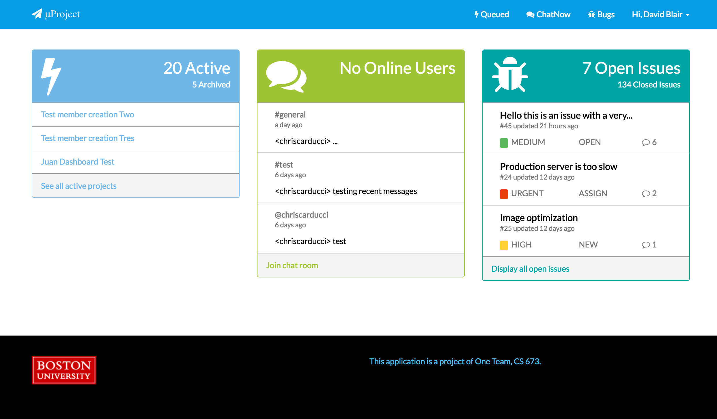
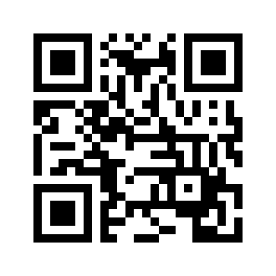
Demo
http://uproject.thirdelement.com
Notes:
Demo:
Dashboard and Login - Srivathsa
Queued - Srivathsa
ChatNow - Chris
Bugs - Jackie

